Slide 1
Introduction
Kidney Stone Prediction Classifier
This binary classification model predicts the likelihood of kidney stones in patients using numerical features such as osmolality and medical history. Trained on 414 entries and tested on 276, it's implemented in Python with Pandas and Scikit-learn.
Why It Is Needed ?
What is Binary Classification ?
Early Diagnosis: Identify kidney stone risk early.
Personalized Treatment: Tailor treatment based on risk.
Preventive Measures: Implement lifestyle changes for high risk.
Resource Allocation: Optimize healthcare resources.
Insights and Research: Drive nephrology research
Binary classification is the process of categorizing data into two distinct groups or classes.

Slide 2
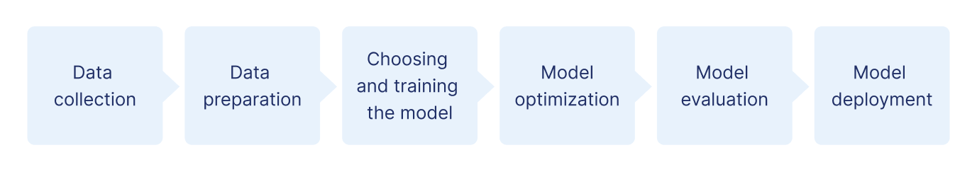
Workflow Diagram

Slide 3
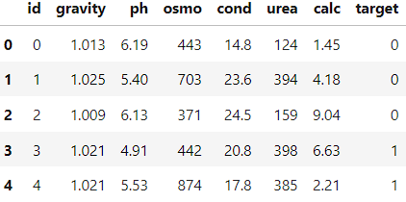
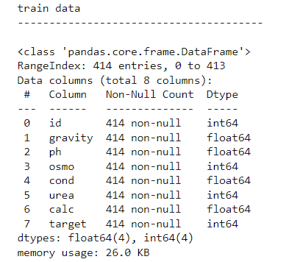
Raw Data Collection
Train Data
id: Unique identifier for each entry.
gravity: Urine specific gravity.
ph: Urine pH level.
osmo: Urine osmolality.
cond: Urine conductivity.
urea: Urea level in urine.
calc: Calcium concentration in urine.
target: Binary indicator for kidney stone presence (1) or absence (0).

Slide 4
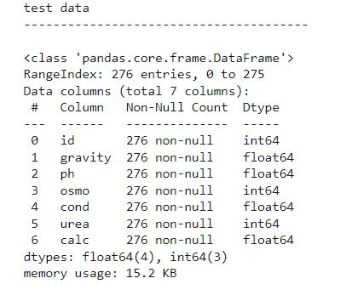
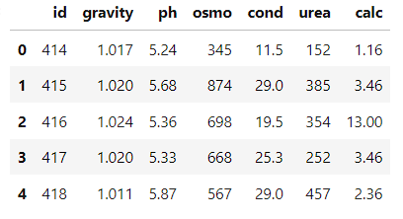
Raw Data Collection
Test Data
Sample data
“target” column is not available , we have to predict for this data

Slide 5
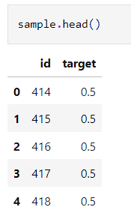
Raw Data Collection
Provided Predicted Sample Data for Test Data
We will use this for evaluating the model accuracy on Test Data

Slide 6
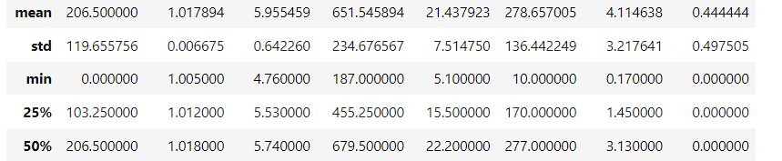
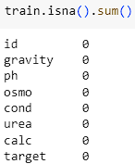

Data Analysing
Statistical Analysis of Training Data
Calculating the number of NaN values
Calculating the number of Duplicated values

Slide 7
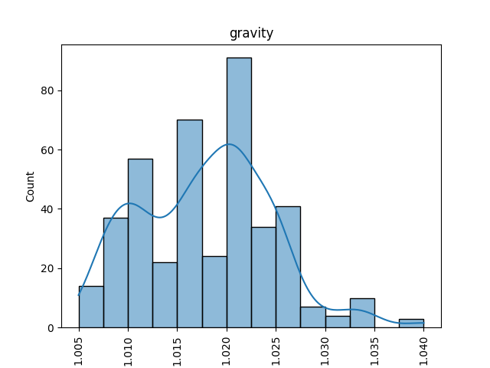
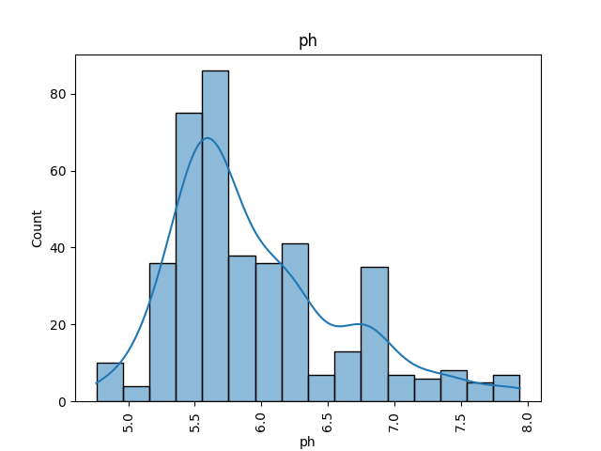
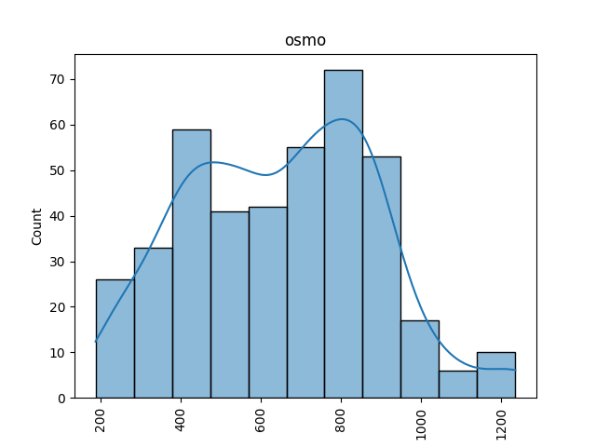
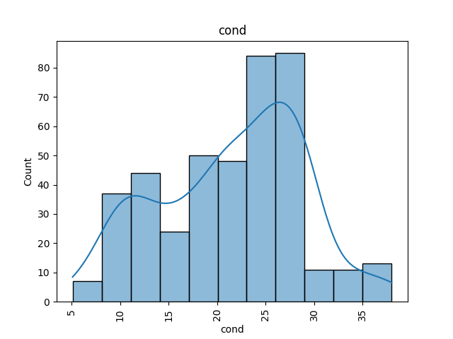
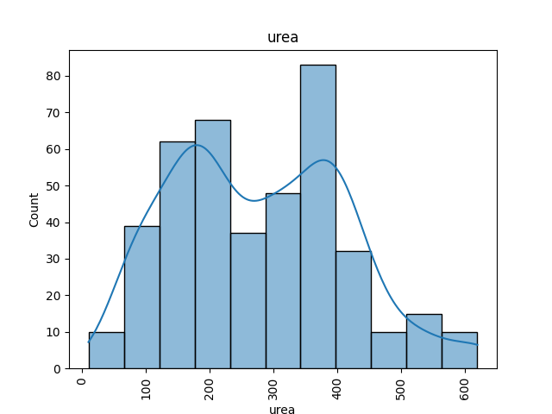
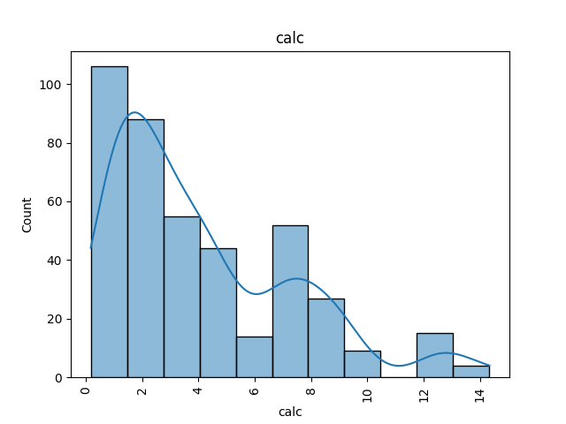
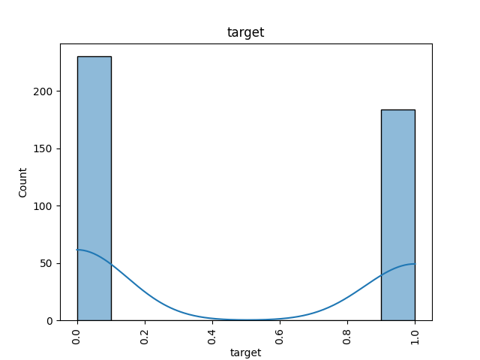
Data Analysing
Analysis the Training data of columns using Charts

Slide 8
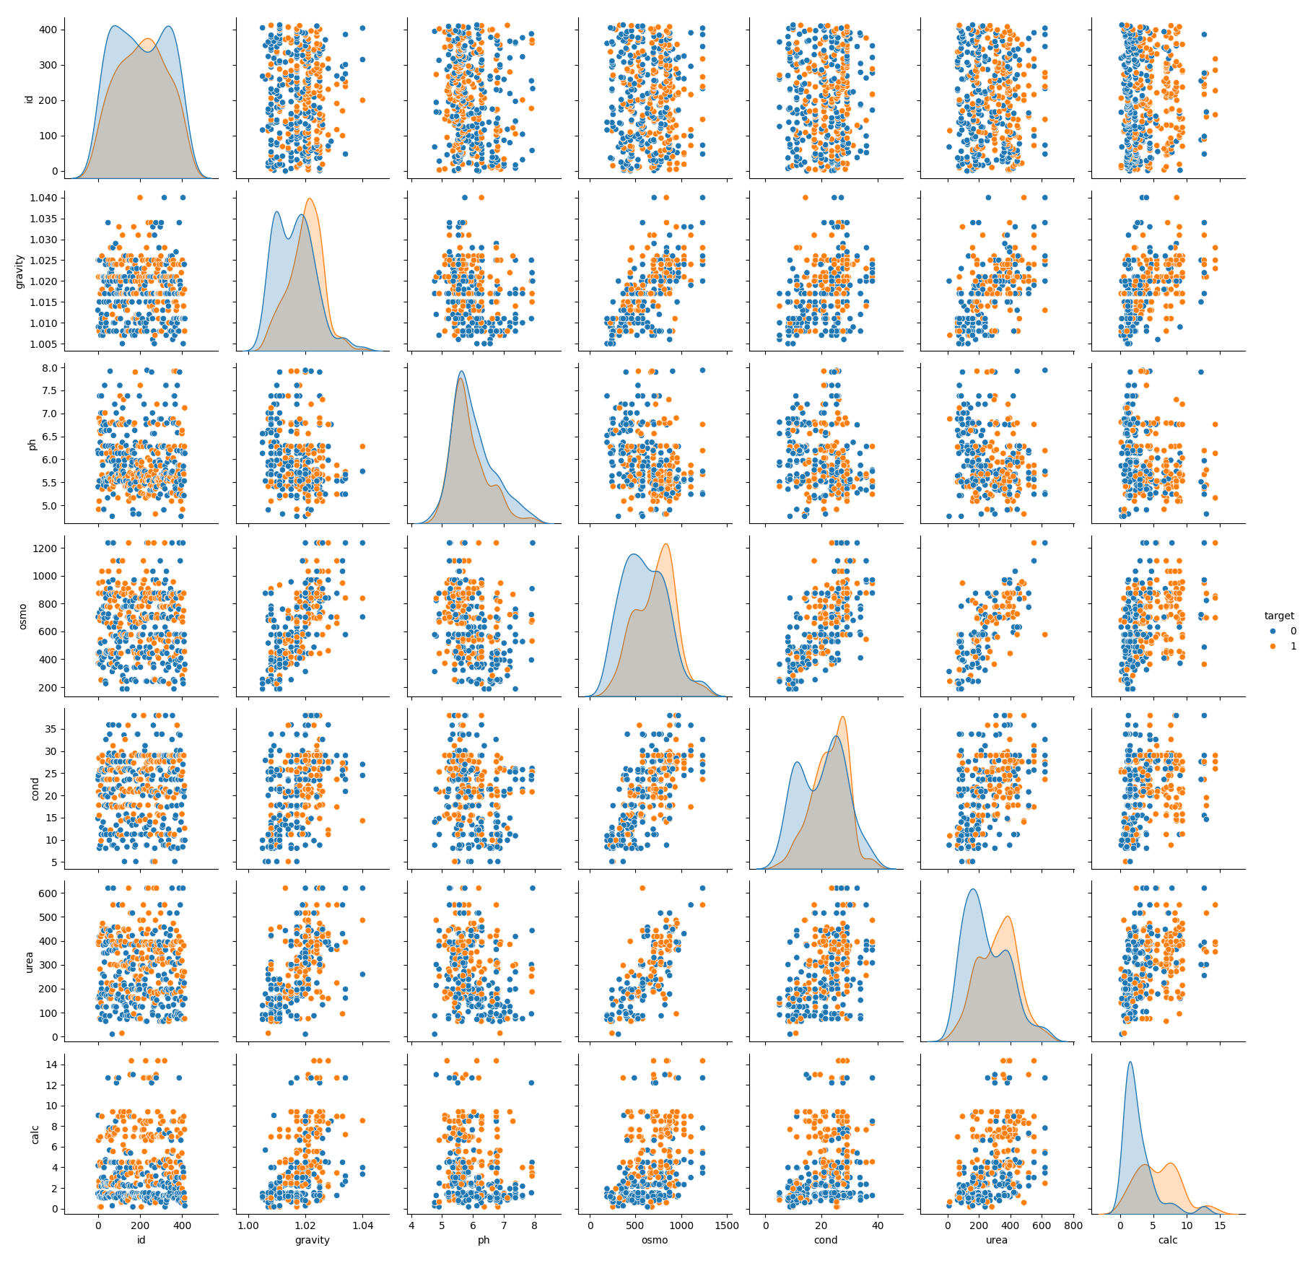
Data Analysing
Pair Plots for Various Parameters

Slide 9
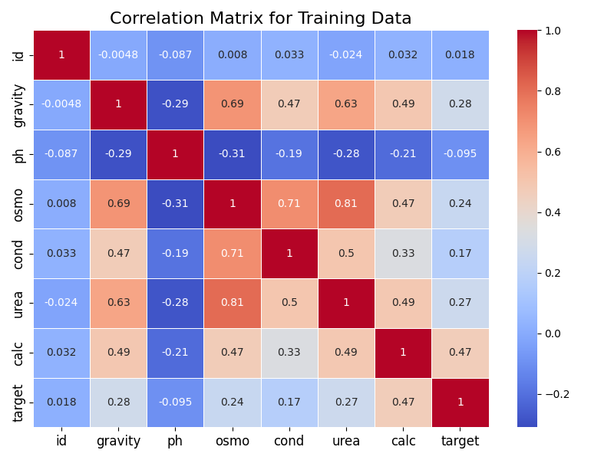
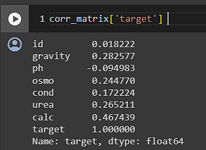
Data Analysing
Correlation Heatmap for Selected Features

Slide 10
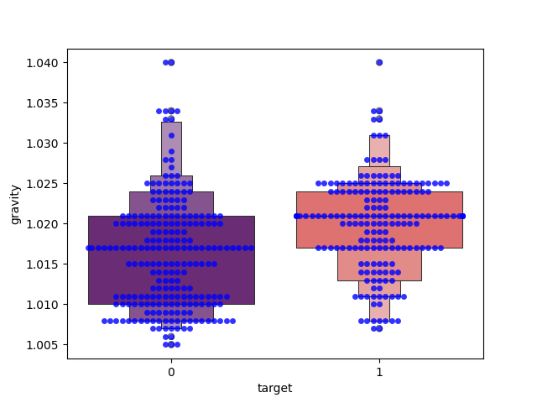
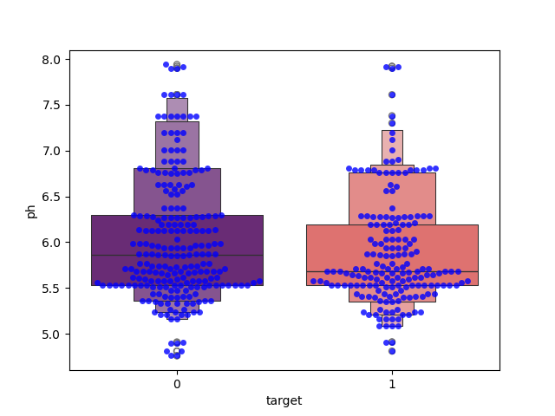
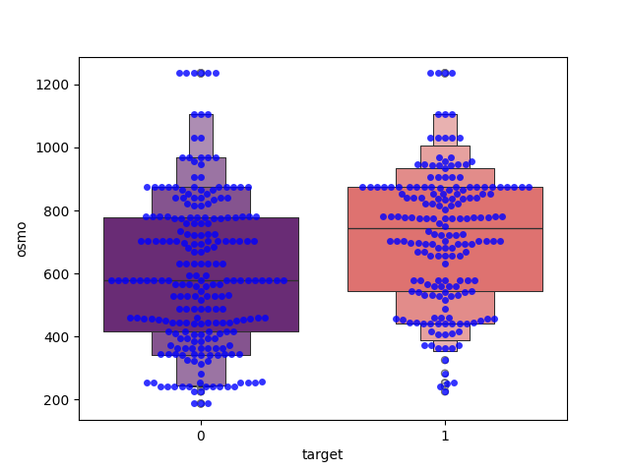
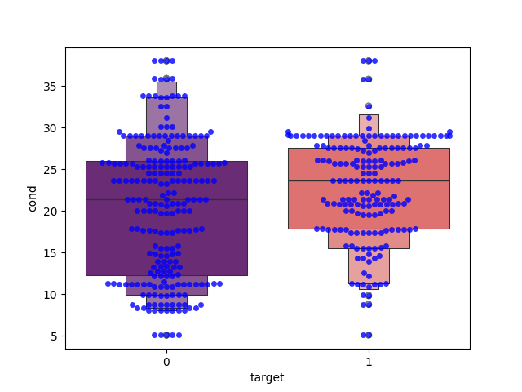
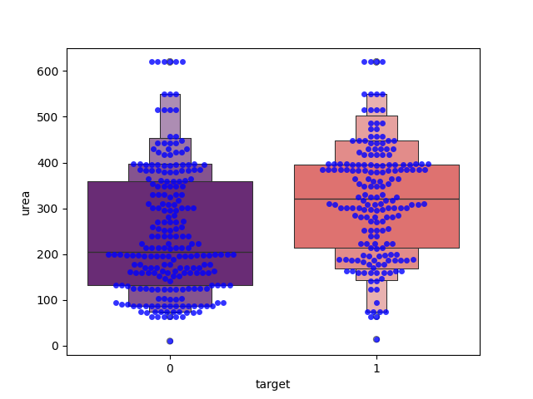
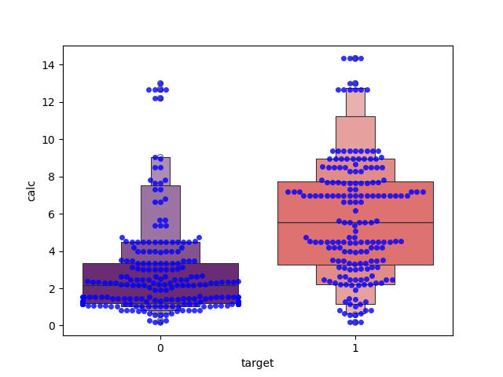
Data Analysing
Box Plots for Various Parameters with respect to “target” Variable

Slide 11

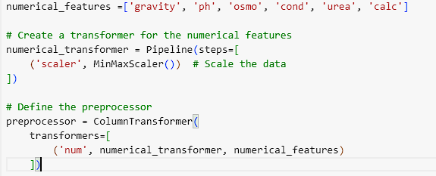
Data Preparation and Preprocessing
Split data into input (X) and output (y) variables
Data Preprocessing
Split data into training and testing sets

Slide 12
Define models and Fit & Evaluate on data to choose best model
Logistic Regression: Linear model estimating the probability of a binary outcome.
Gradient Boosting: Sequential ensemble method minimizing a loss function by adding weak learners.
AdaBoost: Boosting ensemble technique that adjusts the weights of misclassified observations iteratively.
Random Forest: Ensemble learning method constructing multiple decision trees and aggregating their outputs.
XGBoost: Gradient boosting library employing a regularized objective function and tree pruning.
SVM: Supervised learning algorithm seeking the optimal hyperplane to separate classes in feature space.
K-Nearest Neighbors: Instance-based learning method classifying data points based on their nearest neighbors.
Decision Tree: Hierarchical structure of decisions based on feature values to classify instances.
Extra Trees: Ensemble learning technique similar to Random Forests, with more randomized splitting.
Gaussian Naive Bayes: Probabilistic classifier assuming independence among features given the class label.
CatBoost: Gradient boosting algorithm optimized for categorical features with ordered boosting.
SGD Classifier: Linear classifier trained using stochastic gradient descent.
Bagging Classifier: Bootstrap aggregating method training base classifiers on bootstrapped subsets of data.

Slide 13
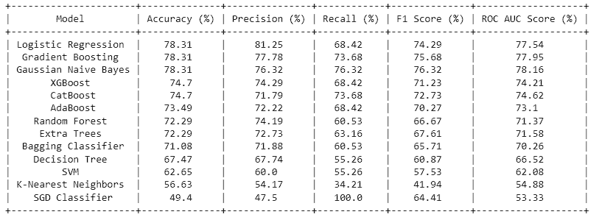
Define models and Fit & Evaluate on data to choose best model

Slide 14
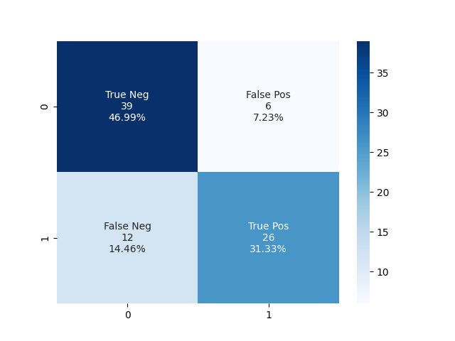
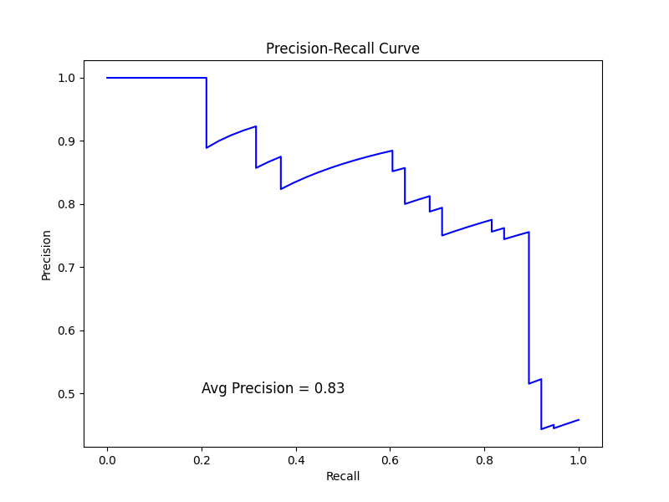
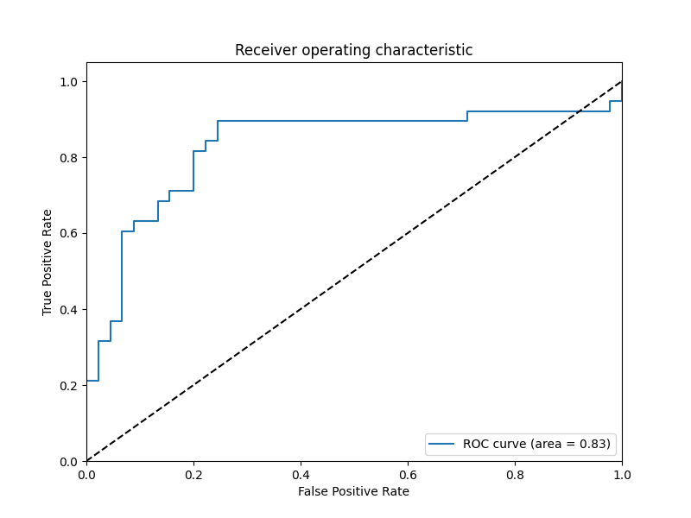
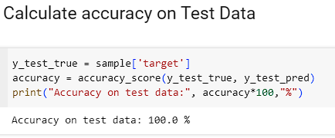
Best Model
Logistic Regression
Confusion Matrix
Precision-Recall Curve
ROC Curve

Slide 15
THANK
YOU …

